Slide 1
Asset Life Cycle
Management System
(ALCMS)
PSNV Information Systems Group
22nd Sep, 2016

Slide 2

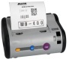
System Overview
1/3
Good receipt
Transfer
Maintenance
Inventory
Scrap
SQL Server
(ALCMS)

Slide 3
System Overview
1/3
Good receipt
Transfer
Maintenance
Inventory
Scrap
Good receipt
Transfer
Maintenance
Inventory
Scrap
Purchase a new one
Approve
Report
Transfer to section
Approve
Report
Update information
Update Serial No.
Inventory checking
Report
Report
When Scrapping
Approve
Approve
Report
Approve
ALCMS

Slide 4
Desktop Function
2/4
SQL Server
Good receipt
Transfer
Maintenance
Inventory
Scrap
Purchase a new one
Approve
Report
Transfer to section
Approve
Report
Update information
Update Serial No.
Inventory checking
Report
Report
When Scrapping
Approve
Approve
Report
Approve

Slide 5
HT Function (When transfer ,inventory)
3/3
Step1
Select function
Select Device type
Select Location
Read barcode of Serial No
Step3
Report Transfer and Inventory data
Offline
Save data to HT
Step0
Step2
Upload master, print barcode label
download data
SQL Server
Online
Save data to SQL Server
Location, Device type, Serial No, Inventory Date
Location(Floor, Area, Table), Device type, Maker

Slide 6




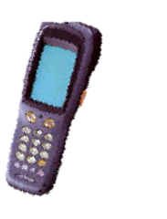
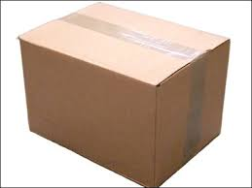
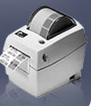



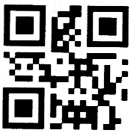
Current Issue & Improvement Activities Theme 2
1/10
7/10
Aim
Manage Asset of IT by barcode.
Optimize all manual jobs by using a management system.
Main Issue
Corrective Action
Result
[3] Develop, testing
Equipment's not barcode.
Lost time for manual job control.
User papers and check sheet to record.
Process of ALCMS
G/R
Transfer
Inventory
Maintenance
Issue Barcode
SQL Server
(ALCMS)
Scrap
Import stationery
Develop new
Software for ISD to manage asset
Export stationery
Report

